Slide 1

Contact Information
Instructor: Engr. Khateeb Khan
Lecturer (Software Engineering)
Department of Computer Science & Information Technology
IQRA University, Islamabad
Email:Muhammad.Khateeb@iqraisb.edu.pk
Office hours:
ACADEMIC BACKGROUND
BS-SE (MUST) MIRPUR, AJK
MS-SE(UET) TAXILA, PAKISTAN
PHD-SE(UET) TAXILA, PAKISTAN ( IN PROGRESS)

Slide 2
Pointers in c++
Definition:
A pointer is a variable that stores the memory address of another variable.
It allows direct manipulation and access to memory locations.
Syntax:
type *pointerName;
Example: int *ptr;

Slide 3
Pointers in c++
Why Pointers
Using pointers, a variable or data-item can be accesses in different parts of a program, where that data-item may or may not be in the scope
Changing a variable’s value in one segment/part of the program will also change the variable’s value in other parts of the program and will help to save space by sharing data-items.
Pointers are very useful to share data-items or values across applications

Slide 4
Pointers in c++
Reference and dereference operators in pointer
we used ampersand sign (&). This sign is called the reference operator. If the reference operator is used you will get the “address of” a variable.
We also used the asterisk sign (*) in the statement. This sign is called the dereference operator. If the dereference operator is used you will get the “value pointed by” a pointer.

Slide 5
Pointers in c++
Basic Example
#include <iostreamint main() {
// Declare a variable
int num = 10;
int *ptr = &num;
scout << "Original Value: " << num << std::endl;
cout << "Memory Address: " << &num << std::endl;
*ptr = 20;
cout << "\nModified Value: " << num << std::endl;
cout << "Memory Address (unchanged): " << &num << std::endl;
return 0;
}
Original Value: 10
Memory Address: 0x7ffeefbff49c
Modified Value: 20

Slide 6
Pointers in c++
How pointers Work
Example
int x=10;
int *y=&x;
Cout<<x;
Cout<<&x;
Cout<<y;
Cout<<*y;
Cout<<&y;

Slide 7
Today Tasks
Write a program that asks the user to enter integers as inputs to be stored in the variables 'a' and 'b' respectively. There are also two integer pointers named ptrA and ptrB. Assign the values of 'a' and 'b' to ptrA and ptrB respectively, and display them.
Take input in variable and display same value by pointer.

Slide 8
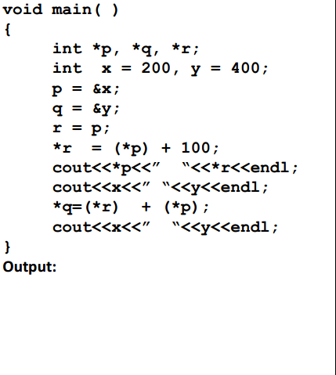
Today Tasks
What will be the output of the following programme.

